Slide 1
MCN 401
INDUSTRIAL SAFETY ENGINERING

Slide 2
Module I (Safety Introduction)
Need for safety.
Safety and productivity.
Definitions: Accident, Injury, Unsafe act, Unsafe Condition, Dangerous Occurrence, Reportable accidents.
Theories of accident causation.
Safety organization- objectives, types, functions,
Role of management, supervisors, workmen, unions, government and voluntary agencies in safety.
Safety policy.
Safety Officer-responsibilities, authority.
Safety committee-need, types, advantages.

Slide 3
Module II (Personal protection in work environment)
Personal protection in the work environment, Types of PPEs, Personal protective equipment respiratory and non-respiratory equipment.
Standards related to PPEs.
Monitoring Safety Performance: Frequency rate, severity rate, incidence rate, activity rate.
Housekeeping: Responsibility of management and employees.
Advantages of good housekeeping.
5 s of housekeeping.
Work permit system- objectives, hot work and cold work permits.
Typical industrial models and methodology.
Entry into confined spaces.

Slide 4
Module III (Safety issues in construction)
Introduction to construction industry and safety issues in construction
Safety in various construction operations – Excavation and filling – Under-water works – Under-pinning & Shoring – Ladders & Scaffolds – Tunneling – Blasting – Demolition – Confined space – Temporary Structures.
Familiarization with relevant Indian Standards and the National Building Code provisions on construction safety.
Relevance of ergonomics in construction safety.
Ergonomics Hazards - Musculoskeletal Disorders and Cumulative Trauma Disorders.

Slide 5
Module IV (Safety hazards in machines)
Machinery safeguard-Point-of-Operation, Principle of machine guarding -types of guards and devices.
Safety in turning, and grinding.
Welding and Cutting-Safety Precautions of Gas welding and Arc Welding.
Material Handling-Classification-safety consideration- manual and mechanical handling.
Handling assessments and techniques- lifting, carrying, pulling, pushing, palletizing and stocking.
Material Handling equipment-operation & maintenance.
Maintenance of common elements-wire rope, chains slings, hooks, clamps.
Hearing Conservation Program in Production industries.

Slide 6
Module V (Hazard identification and analysis)
Hazard and risk, Types of hazards –Classification of Fire, Types of Fire extinguishers, fire explosion and toxic gas release, Structure of hazard identification and risk assessment.
Identification of hazards: Inventory analysis, Fire and explosion hazard rating of process plants - The Dow Fire and Explosion Hazard Index, Preliminary hazard analysis, Hazard and Operability study (HAZOP)) – methodology, criticality analysis, corrective action and follow-up.
Control of Chemical Hazards, Hazardous properties of chemicals, Material Safety Data Sheets (MSDS).

Slide 7
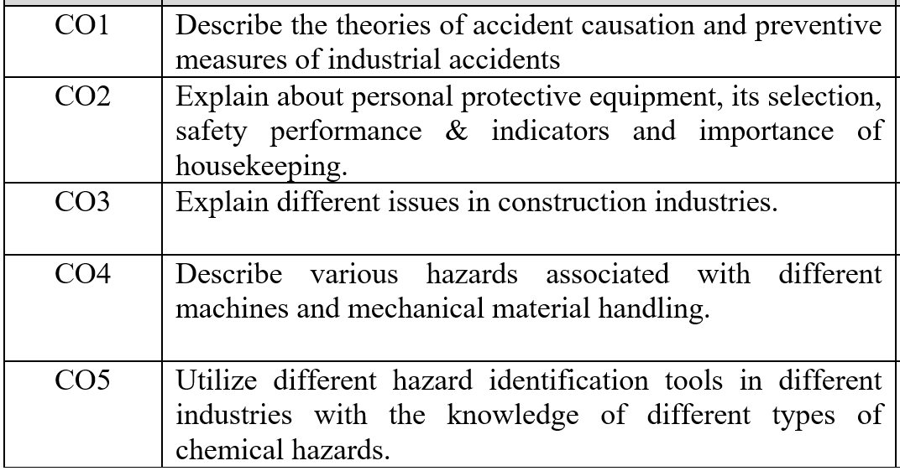
Course Outcomes

Slide 8
Module I (Safety Introduction)
Need for safety.
Safety and productivity.
Definitions: Accident, Injury, Unsafe act, Unsafe Condition, Dangerous Occurrence, Reportable accidents.
Theories of accident causation.
Safety organization- objectives, types, functions,
Role of management, supervisors, workmen, unions, government and voluntary agencies in safety.
Safety policy.
Safety Officer-responsibilities, authority.
Safety committee-need, types, advantages.

Slide 9
What is Safety and what is it's significance ?
Safety is necessary everywhere and at all times, in homes, on roads, in offices, public places, while travelling, in working in Industry.
Industry has more hazardous situations and activities than home or an office.
Many persons work as a team in an industry and Safety is of interest to every individual, group of individuals and the total organization.
Every individual in the society and an industrial organization has obligation to organise and establish safety disciplines.
Safety Management is an essential and important part of industrial management.
Management is responsible to provide safe working condition and individual's safety.
Lapse on the part of management and individuals may result in an accident or disaster.

Slide 10
Industry Safety
Industrial safety is primarily an activity that management is concerned with reducing, controlling, and eliminating hazards from the industries or industrial units.
This can take the form of being protected from the event or from exposure to something that causes health or economical losses.
Industrial safety encompasses the prevention of a wide variety of industrial hazards, occupational accidents and work-related illnesses in order to create a “zero-risk” environment.
While this is a challenging task, effective prevention strategies at the enterprise, national, regional and international levels can eliminate, or at least minimize, the occurrence and impacts of industrial hazards.
Industrial safety mechanisms should begin at the firm level and expand to industrial sectors, national regulatory systems, regional monitoring entities and international organizations promoting industrial development.

Slide 11
Need for safety
The importance of industrial safety was realized because of the fact that every year millions of industrial accidents occur which result in loss of production time equivalent to millions of man hours, machine hours etc.
Of these about one-fifth production time is lost by those actually injured due to temporary and permanent disablement and the remaining production time is lost by fellow operators/ people in helping the injured, in taking care of the damage caused by accident etc. the loss to the industrial unit would appear much more alarming when death cases due to accidents are considered.
It is therefore essential to identify/examine the causes of industrial accidents and take steps to control them.
Many disciplines are concerned with this safety approach.
Industrial engineering is one field which deals with design of efficient work place, equipment and industrial layout design.
Other disciplines which can contribute to safe working environment are psychology, sociology and Medicare science.

Slide 12
Need for safety
Need and concern for safety is very important.
There are some direct costs/ effects of an accident but there are certain indirect costs involved in it also
  Cost of compensation
  Cost of medical-aid
  Cost of training a new worker
  Cost of the lost time
  Cost of investigation
  Cost of supervision & inspections
  Cost to the Govt. in terms of factory inspectors, & public health services

Slide 13
Need for safety
Safety measures would not only eliminate/ avoid above cost, but would mean performing their moral responsibility towards workmen/operators also.
  To protect health of all employees
  To ensure well being of all workers
  To promote positive culture in all organization or company
  To ensure accident and incident prevention
  To ensure organization development and its growth
  To ensure continual improvement of company

Slide 14
Objective of safety management in Industry
To prevent accidents in the plant by reducing the hazard to minimum.
To eliminate accident caused work stoppage and lost production.
To achieve lower workmen's compensation, insurance rates and reduce all other direct and indirect costs of accidents.
To prevent loss of life, permanent disability and the loss of income of worker by eliminating causes of accidents.
To evaluate employee's morale by promoting safe workplace and good working condition
To educate all members of the organization in continuous state of safety mindless and to make supervision competent and intensely safety minded

Slide 15
Four E’s of safety
Engineering: i.e. safety at the design, equipment installation stage.
Education: i.e. education of employees in safe practices.
Enlistment: i.e. it concerns the attitude of the employees and management towards the program and its purpose. This necessary arose the interest of employees in accident prevention and safety consciousness.
Encouragement: i.e. to enforce adherence to safe rules and practices.

